Slide 1
Middleware Application
Dashboard
[26th-Dec-15 to 1st-Jan-15]
IT Application Support
Concentrix, INDIA

Slide 2
DB2
Planned Downtime [26th Dec– 1st Jan ]
Activity/Reason | Date/Time From | Date/Time To | Duration | Remarks
SUCCESS
FAILED
SUCCESS
FAILED
2

Slide 3
Services & Parameters List
(SQL & IIS)
SQL Server
    Service Name:
      SQLSERVR.EXE
      SQLAGENT90.EXE
      SQLAGENT.EXE
    Parameter Name:
      User Connections
      Total Server Memory (KB)
      Target Server Memory (KB)
      Buffer Cache Hit Ratio
      Page Reads/sec
      Page Writes/sec
      Page Life Expectancy
      Fragmentation (%) of Most Fragmented Table
      Fragmented Tables in Database
      Transactions/sec
      Total Size (KB) of Database Files
      Longest Transaction Running Time
      Deadlocks/sec
      Total Size (KB) of Log Files
IIS Server
    Service Name:
      INETINFO.EXE
      SVCHOST.EXE
    Parameter Name:
      IIS Admin Service
      World Wide Web Publishing Service
      HTTP Port Monitor
      URI Cache Flushes Counter
      URI Cache Hits Counter
      URI Cache Hits Percent Counter
      URI Cache Misses Counter
      Bytes Received/sec Counter
      Bytes Sent/sec Counter
      Bytes Total/sec Counter
      Connection Attempts/sec Counter
      Current Connections Counter
      Get Requests/sec Counter

Slide 4
Services & Parameters List
(DB2)
DB2 Server
    Service Name:
      db2syscs.exe
      db2sysc
    Parameter Name:
      Database Used Space (MB)
      Log File Free Space in Specified Database (MB)
      Number of Locks Held in Specified Database
      Average Read Time (ms)
      Connected applications to Specified Database
      Number of Long Running Queries
Note: DB2 Parameters are given to NOC team but not yet configured because there is some driver need to be installed in SolarWinds server and NOC team are working on that.

Slide 5
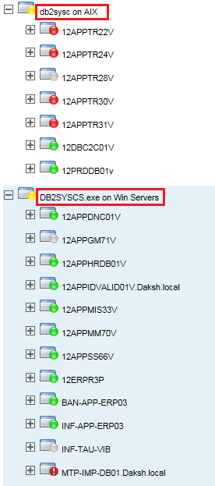
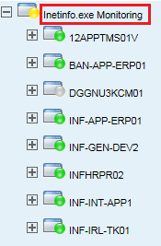
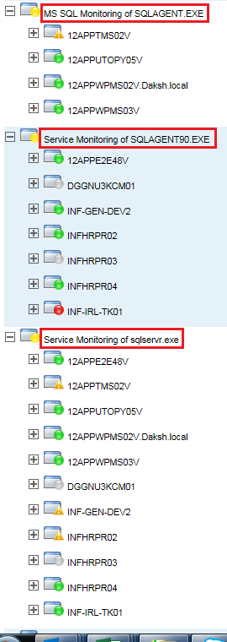
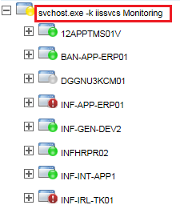
DB2 / SQL / IIS
Services Configured Servers List
DB2
IIS
SQL

Slide 6
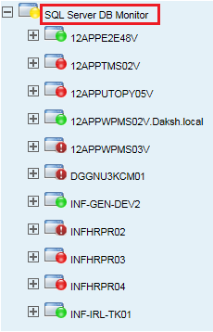
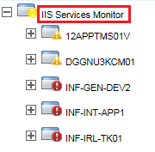
DB2 / SQL / IIS
Parameters Configured Servers List
IIS
DB2
IN-PROGRESS
SQL

Slide 7
SUMMARY
SQL
- Payroll Production Server(INFHRPR03) & KCOM, there is no data found for CPU & Memory utilization in SolarWinds
DB2
- Disk Volumes, CPU & Memory utilization data is not found Resolve Jiffy (12APPTR28V) server.
WAS
- SAPS application’s CPU Utilization data not found
Note:
There are some issues facing by NOC team that’s related to (SNMP string, Server Unknown Stage, DB2 Service Not found in AIX, SQL Connectivity) on some of the servers. Hence in the picture servers are showing in Red, Brown, Orange color. We are working on this and will short out the issue ASAP.

Slide 8


